Slide 1
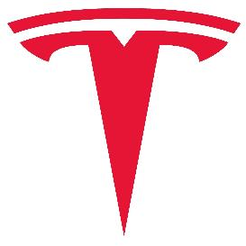
Case Study of Tesla
KNOWLEDGE MANAGEMENT PROJECT

Slide 2
Knowledge Management
Project Title: Case study of Tesla
Project Guide: Prof.Krupesha
Project Team: 2

Slide 3
Team
Mayur RB - PES1201700714
Jnanesh D - PES1201701822
Sachin - PES1201701725
Sujay Gad - PES1201700177
Revanth Yalipi - PES1201700201

Slide 4
Project Abstract and Scope
In this project we dig into Tesla Inc and find out its working, products offered their Business strategies and a case study to find out how they popularised electric cars and we also find out the problems they currently face

Slide 5
Introduction
Tesla, Inc. (formerly Tesla Motors, Inc.), is an American electric vehicle and clean energy company based in Palo Alto, California
The company specializes in electric vehicle manufacturing, battery energy storage from home to grid scale and, through its acquisition of SolarCity, solar panel and solar roof tile manufacturing.
Tesla Motors was founded in July 2003 by engineers Martin Eberhard and Marc Tarpenning. The company's name is a tribute to inventor and electrical engineer Nikola Tesla

Slide 6
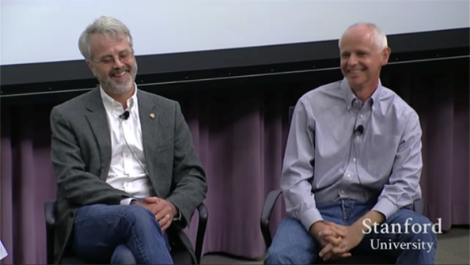
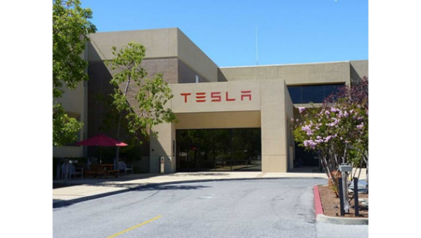
Introduction
Founders Martin Eberhard and Marc Tarpenning
Tesla Headquarters at Palo Alto
Notes:
Sir regarding your question: Martin Eberhard graduated as an electrical engineer. And Marc Tarpenning graduated as an Computer science engineer from UC Berkeley, it is highly unlikely they entered teaching career, so the photo of them in this slide is of them talking as guest speakers at Stanford University

Slide 7
Introduction
After 11 years in the market, Tesla ranked as the world's best-selling plug-in as well as best-selling battery electric passenger car manufacturer by cars sold in 2019.
Both as a brand and by automotive group, with a market share of 17% of the plug-in segment and 23% of the battery electric segment.
Tesla global vehicle sales increased 50% from 245,240 units in 2018 to 367,849 units in 2019.
Tesla’s mission is to accelerate the world’s transition to sustainable energy.

Slide 8
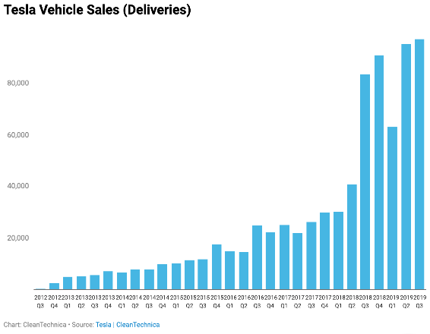
Introduction
Tesla’s Quarterly sales from 2012

Slide 9
History
Tesla Motors was incorporated in July 2003 by Martin Eberhard and Marc Tarpenning with 98% of the initial funds being provided by Chairman of the Board Elon Musk, who appointed Eberhard to be the first CEO.
The founders were influenced to start the company after GM recalled all its EV1 electric cars in 2003 and then destroyed them.
And seeing the higher efficiency of battery-electric cars as an opportunity to break the usual correlation between high performance and low mileage.

Slide 10
History
Elon Musk led the Series A round of investment in February 2004, joining Tesla's board of directors as its chairman.
Musk took an active role within the company and oversaw Roadster product design at a detailed level. In addition to his daily operational roles, Musk was the controlling investor in Tesla from the first financing round, funding $6.5 million of the Series A round of US$7.5 million with personal funds
Tesla's primary goal was to commercialize electric vehicles, starting with a premium sports car aimed at early adopters and then moving into more mainstream vehicles, including sedans and affordable compacts

Slide 11
Knowledge Management at Tesla Motors
Knowledge management (KM) has been a process of capturing, sharing, developing and effectively using the organizational knowledge. It is referred to as a term that helps in achieving the organizational objectives by making the best use of knowledge provided. Some of the concepts that have been used by the firm are as follows.

Slide 12
Knowledge Management at Tesla Motors
Understand key drivers of business:
The first step of successful KM in a firm is to understand the key drivers of the business
In case of Tesla Motors, the key drivers for the company are the electronic car that has been the major source of revenue generation; therefore it has to be well presented in the market.

Slide 13
Knowledge Management at Tesla Motors
Implement in phases
The final phase of KM is the implementation phase. This is the place where the firm has to execute the strategies it plans to integrate in the firm.
The management has to ensure that the company and all its departments are aligned with the Km objectives and initiates.

Slide 14
Knowledge Management tools used by Tesla
Customer Relationship Systems
Competitors know that customer ownership is a much bigger hill to climb than power density. Tesla is gradually converting that hill into an impenetrable wall.
Constant improvement, customer ownership, data collection and analysis are all hallmarks of the not-so-secret weapon of vehicle connectivity deployed by Tesla.
Whether or not Tesla can build, sell and maintain cars profitably remains to be seen, but Tesla has mastered the customer relationship fundamentals.

Slide 15
Knowledge Management tools used by Tesla
Content repositories: Tesla doesn't keep any of its technology as classified info, in fact they have made it open source so that open source tech developers can use their creativity to improve the company's image.
This leads to newer innovations being added. Tesla has an open source github repository for the developers to work upon.

Slide 16
Knowledge Management tools used by Tesla
Communication Tool
Tesla Motors (TM) employs a range of marketing communication tools and strategies in order to target current and potential customers.
TM’s social media marketing strategy enables TM to increase brand recognition and to improve brand loyalty. Social media platforms such as Twitter or blogs boost TM’s popularity, credibility and brand recognition.

Slide 17
ELON MUSK: TESLA'S INTERNAL COMMUNICATION PROTOCOL CAN CHALLENGE BIG AUTO INERTIA
There are two schools of thought about how information should flow within companies. By far the most common way is chain of command, which means that you always flow communication through your manager. The problem with this approach is that, while it serves to enhance the power of the manager, it fails to serve the company.
Instead of a problem getting solved quickly, where a person in one dept talks to a person in another dept and makes the right thing happen, people are forced to talk to their manager who talks to their manager who talks to the manager in the other dept who talks to someone on his team.
Anyone at Tesla can and should email/talk to anyone else according to what they think is the fastest way to solve a problem for the benefit of the whole company. You can talk to your manager's manager without his permission, you can talk directly to a VP in another dept, you can talk to me, you can talk to anyone without anyone else's permission.
Moreover, you should consider yourself obligated to do so until the right thing happens. The point here is not random chitchat, but rather ensuring that we execute ultra-fast and well. We obviously cannot compete with the big car companies in size, so we must do so with intelligence and agility.
One final point is that managers should work hard to ensure that they are not creating silos within the company that create an us vs. them mentality or impede communication in any way. This is unfortunately a natural tendency and needs to be actively fought.

Slide 18
DESIGN PERSPECTIVE - KM
In order to increase the impact of academic research, it is important that we develop and strengthen national and international networks for knowledge transfer and translation.
There is a dynamic interplay between knowledge creation, product development and market adoption; each co-evolves within an interconnected system of actors.
TESLA will apply approaches from Design Thinking to support concurrent rather than sequential research, development and commercialisation activities.
Thereby accelerating the selection and the increasing the fitness of emerging technologies, products and services.

Slide 19
DESIGN PERSPECTIVE
Research creates new knowledge and new technologies, which often lead to innovation with commercial and societal impact. TESLA will explore ways to accelerate innovation and amplify impact, through using design-led interdisciplinary approaches to innovation.
Knowledge transfer is not just one way, however; by collaborating with industrial and commercial partners, we are able to maintain the professional relevance of the undergraduate and postgraduate curriculum, which is crucial to the employability of our graduates.
Increasingly open innovation-networks, processes and communication technologies promise to further accelerate the development and adoption of new technologies, products and services. TESLA will strengthen interdisciplinary collaboration within a diverse, adaptive and sustainable ecology of academic, industrial and commercial partners.

Slide 20
KM Roles at Tesla:
1)Knowledge manager-
Roles and responsibilities include working cross-functionally with Product Managers, Training Program Managers and technical writers to develop effective, interesting, and engaging knowledge management solutions for the Energy products at Tesla.
Standardize content across each Product informational repository for consistent and relevant information for all functional teams. Gather usability feedback from end-users for continual format and delivery improvements.

Slide 21
KM Roles at Tesla:
2)Knowledge management administrator-
The Knowledge Management Administrator is responsible for actively collaborating with IT counterparts to continue development and completion of a high quality, user-friendly sales and service knowledge management system (called TRT) that can be leveraged by Retail Development, as well as its internal business partners and external vendors.

Slide 22
3 . Knowledge Base Content Editor, Service Engineering
Service Engineering exists uniquely at the intersection of firmware/hardware design, service, diagnostics, manufacturing, quality, and reliability.
Service Engineering multiplies efforts of service in the areas of diagnostics, repairs, and maintenance, while simultaneously reducing the need for each.
As Service Engineering Technical Writer, he will partner with engineering teams to create and refine diagnostic procedures and documentation for use by non-engineers.
He will improve editorial and visual standards for documentation and recommend new designs, layouts, and formatting as needed.

Slide 23
How Tesla has taken advantage of KM-
Tesla took a gamble by sharing patents that covered its revolutionary electric vehicles for free.
Sharing of patents could have resulted in competitors catching up but the pro was that sharing of patents was a claim of authenticity which resulted in brand enhancement.
Thus, the best engineers would flock to Tesla, attracted by its spirit of openness, innovation and dedication to a social mission.
In this way knowledge assets (patents) were used by Tesla in the growth of the company.

Slide 24
Knowledge Management Tesla Motors SWOT analysis
The acronym Knowledge Management SWOT stands for strength, weakness, threats and opportunities. This SWOT analysis shows that the company has the strengths needed to maintain profitability in the long term.
In this company analysis case of Tesla, the following strengths shape the capabilities of the business as a competitive player in the automotive industry:
Highly innovative processes
Strong brand
Strong control on production processes
Tesla’s Weaknesses (Internal Strategic Factors)
Limited market presence
Limited supply chain
High prices

Slide 25
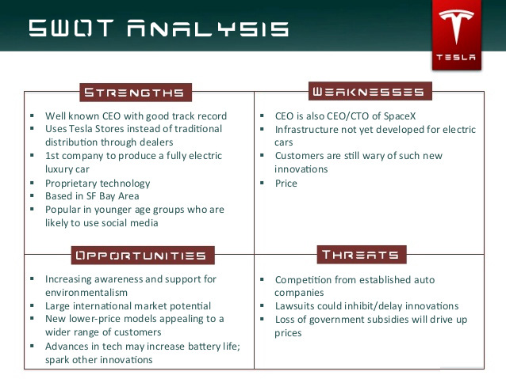

Slide 26
Tesla, Inc.’s Operations Management, 10 Decision Areas
Design of Goods and Services - In this strategic decision area, operations managers focus on how the organization’s products influence costs, quality objectives and resources
Quality Management - Satisfying customers’ quality expectations is the main objective in this strategic decision area of operations management
Process and Capacity Design - This operations management decision area focuses on business processes, along with related investments, resources, and standards
Location Strategy - Logistics and nearness to markets, resources and suppliers are considered in this strategic decision area of operations management
Layout Design and Strategy - In this strategic decision area, operations management is concerned with achieving optimal flow of resources and information
Job Design and Human Resources - Adequacy of effective human resources is the objective in this strategic decision area of operations management
Supply Chain Management - In this strategic decision area, operations managers focus on adequate supply and an effective and efficient supply chain.
Inventory Management - Inventory decisions, costs and support for production are considered in this strategic decision area.
Scheduling - This strategic decision area focuses on short-term and intermediate schedules for resource utilization
Maintenance - Adequacy of resources and production capacity are the objectives in this strategic decision area of operations management

Slide 27
Strategy
Tesla's business strategy is to emulate typical technological-product life cycles and initially target affluent buyers, and then move into larger markets at lower price points.
The battery and electric drivetrain technology for each model would be developed and partially paid for through the sales of earlier models.
The Roadster was low-volume and priced at US$109,000. Model S and Model X target the broader luxury market. Model 3 and the Model Y are aimed at a higher-volume segment.

Slide 28
Strategy
The Tesla Patent Wall at its headquarters was removed after the company announced its patents are part of the open source movement.
Tesla's sales strategy is to sell its vehicles online and in company-owned showrooms rather than through a conventional dealer network. Moving towards an e-commerce strategy, customers are able to customize and order their vehicles online

Slide 29
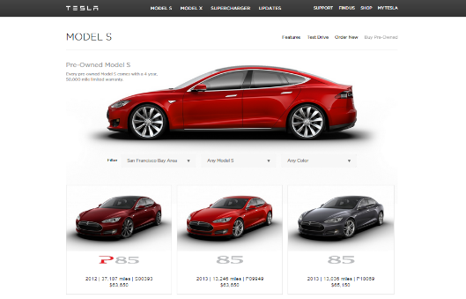
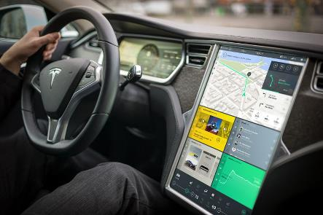
Strategy
A screengrab of the Tesla Website
Tesla Model S driver UI

Slide 30
Strategy
Tesla allows its technology patents to be used by anyone in good faith. Licensing agreements include provisions whereby the recipient agrees not to file patent suits against Tesla, or to copy its designs directly.
“There’s a lot of thinking in the research these days on the gap between the codified knowledge that is patentable and gets disclosed versus tacit knowledge that really exists in how you actually produce,” says Orly Lobel, a law professor at the University of San Diego specializing in intellectual property.
Tesla retained control of its other intellectual property, such as trademarks and trade secrets to prevent direct copying of its technology.

Slide 31
Tesla’s Patent Sharing
There was a wall of Tesla patents in the lobby of our Palo Alto headquarters. That is no longer the case. They have been removed, in the spirit of the open source movement, for the advancement of electric vehicle technology.
Tesla Motors was created to accelerate the advent of sustainable transport. If we clear a path to the creation of compelling electric vehicles, but then lay intellectual property landmines behind us to inhibit others, we are acting in a manner contrary to that goal. Tesla will not initiate patent lawsuits against anyone who, in good faith, wants to use our technology.
At Tesla, however, we felt compelled to create patents out of concern that the big car companies would copy our technology and then use their massive manufacturing, sales and marketing power to overwhelm Tesla.
We couldn’t have been more wrong.The unfortunate reality is the opposite: electric car programs (or programs for any vehicle that doesn’t burn hydrocarbons) at the major manufacturers are small to non-existent, constituting an average of far less than 1% of their total vehicle sales.
Elon Musk in his blog

Slide 32
How is Tesla different than regular car dealerships?
Rather than working like a franchised dealership, Tesla skips the middle man and sells directly to its customers. Tesla doesn’t have dealerships, they have Tesla Stores, and they’re usually found integrated into a popular mall or shopping center. This is a calculated decision; by placing their stores in populated areas, busy traffic flows in and out of the stores regularly, even if it’s just to see what all of the hype is about.
But Tesla Stores work differently than car dealerships, primarily because customers can’t buy a Tesla in the store. Because of the franchise laws surrounding car sales, Tesla customers have to purchase their vehicles online. Automotive manufacturers are prohibited from in-person direct sales. So if you buy a car off a lot, you’re buying from a franchised dealership.

Slide 33
Tesla Inc.’s Organizational Structure Type & Features
Tesla has a functional or U-form organizational structure. The unitary-form (U-form) structure uses organizational function as the main defining factor. For example, the company has a structural group of employees for engineering, and another for sales and service. The following characteristics are significant in Tesla’s organizational structure
Function-based hierarchy (most important)
Centralization
Divisions

Slide 34
Function-Based Hierarchy. The most significant characteristic of Tesla’s corporate structure is the function-based hierarchy in its global organization. This hierarchy involves functional teams or offices that oversee domestic and international operations.
Chairman & Chief Executive Officer
Finance
Technology
Global Sales and Service
Engineering
Legal

Slide 35
Centralization. Tesla, Inc. uses centralization in its corporate structure. The emphasis of centralization is managerial control on the entire organization through decisions that a central group or team generates.
In this case, the heads of the offices of the global hierarchy form the corporation’s central headquarters, which directly control all operations. In this organizational structure, Tesla minimally supports the autonomy of its regional or overseas offices. The company’s headquarters make most of the decisions for overseas operations
Divisions. This characteristic of the corporate structure focuses on the extent of geographical or other types of divisions in Tesla Inc.’s automotive business.
These divisions are used to implement different strategies and marketing campaigns, and to organize financial records and reports. The company’s main divisions in its corporate structure are (1) Automotive and (2) Energy Generation and Storage.
These divisions are less significant compared to the function-based hierarchy of the organization

Slide 36
Tesla’s Corporate Structure: Implications, Advantages & Disadvantages
Tesla, Inc. benefits from its corporate structure in terms of effective managerial control of multinational operations. Another advantage is the ease of implementing new strategies throughout the organization. Also, the regional divisions support financial reporting and analysis, and provide the foundation for future regionalization of strategies and tactics in the international automotive market. These advantages empower Tesla to use its organizational structure for further international growth and to build competitiveness against Toyota Motor Corporation, Honda Motor Company, Nissan Motor Company, General Motors Company, Volkswagen, Bavarian Motor Works (BMW), and other car manufacturers. The organizational structure enables the company to centrally control the development of competitive advantages.
A disadvantage of Tesla’s corporate structure is the rigidity that limits rapid adjustment in the organization. For example, global centralization is a structural characteristic that limits the autonomous ability of overseas offices to readily respond to issues they experience in their respective regional markets. To address this disadvantage, it is recommended that Tesla Inc. reform its organizational structure to increase the level of autonomy of overseas offices. A corporate structure with a higher degree of decentralization tends to be more effective in creating competitiveness against local firms in overseas markets.

Slide 37
Tesla Inc.’s Organizational Culture & Its Characteristics (Analysis)
A firm’s organizational or corporate culture represents the customs and values that define workers’ behaviors and decisions. Tesla’s organizational culture empowers its workforce to search for ideal solutions that make the business stand out in the automotive industry and the energy generation and storage industry
The company encourages employees to innovate to support continuous improvement of the business. For example, through its corporate culture, Tesla maintains the human resource capabilities important in its continuing growth in the global market for electric automobiles, batteries, solar panels, and related products.
In this way, the corporation’s cultural traits function as a channel for adding to strategic effectiveness in enhancing the business. Through the organizational culture, Tesla Inc.’s management optimizes employees to achieve creative and innovative behaviors.
Tesla’s organizational culture creates opportunities for innovation that keeps the competitiveness of the electric car business

Slide 38
LEADERSHIP IN THE DISRUPTIVE ERA
Elon Musk had proved himself to be the greatest influencer for the company with his strong technical background and unflinching vision for the company. It is not only the industry that has undergone change but also the workforce, its diversity, technology, pace of change and knowledge updation methods. The shift from the industry era to the knowledge era has now compelled leaders to change their styles
The leaders of today need to be dynamic, adaptive and interactive as the new technologies are volatile and it needs a great acumen of predictability to lead the change

Slide 39
Advantages of KM
Improved organisational agility
Better and faster decision making
Quicker problem-solving
Increased rate of innovation
Supported employee growth and development
Sharing of specialist expertise
Better communication
Improved business processes

Slide 40
Technologies of the company
1 . Batteries
Unlike other automakers, Tesla does not use individual large battery cells, but thousands of small, cylindrical, lithium-ion commodity cells like those used in consumer electronics
Tesla's batteries are manufactured in Gigafactories, the name Gigafactory comes from the word 'Giga,' the unit of measurement representing “billions.” It uses a version of these cells that is designed to be cheaper to manufacture and lighter than standard cells by removing some safety features.

Slide 41
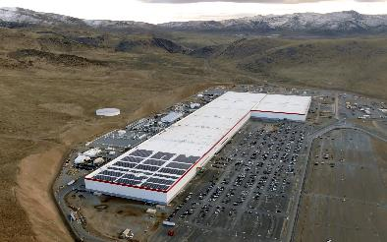
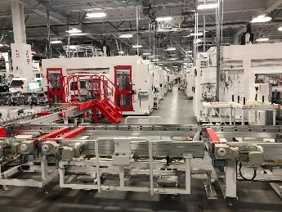
Technologies of the company
Giga Nevada
Inside a Giga Factory

Slide 42
Technology
2.Motors
Tesla makes two kinds of electric motors. Their oldest currently-produced design is a three-phase four-pole AC induction motor with a copper rotor (which inspired the Tesla logo), which is used as the rear motor in the Model S and Model X.
Newer, higher-efficiency motors are used in the Model 3, Model Y, Semi, and the front motor of 2019-onward versions of the Model S and X. The permanent magnet motors increased efficiency, especially in stop-start driving

Slide 43
Technology
3. Autopilot
In September 2014, Tesla Autopilot started providing semi-autonomous driver assist. Tesla upgraded its sensors and software in October 2016 (hardware version 2, or "HW2"); all Tesla cars built since then come standard with Autopilot hardware.
As of 2017, Autopilot included adaptive cruise control, lane departure warning, emergency braking, Autosteer (semi-automated steering), Auto park (parallel and perpendicular parking) and Summon (recalling the vehicle from a parking place).

Slide 44
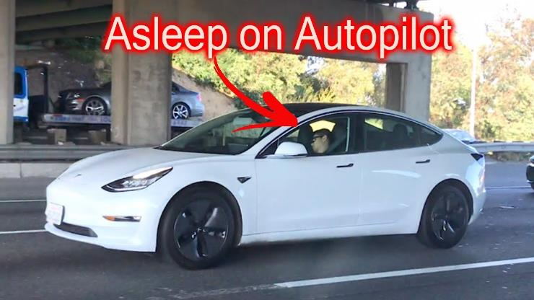
Technology(Autopilot)
A guy caught sleeping while driving a Tesla Model 3 in autopilot

Slide 45
Vehicle Models
As of January 2020, Tesla offers four car models: The Model S, Model 3, Model X and Model Y.
1 . Model S
The Model S is a five-door lift back sedan. Deliveries began on June 22, 2012. The first delivery in Europe took place in August 2013.

Slide 46
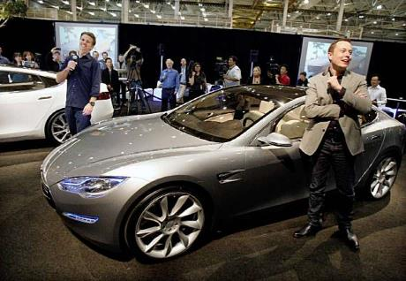
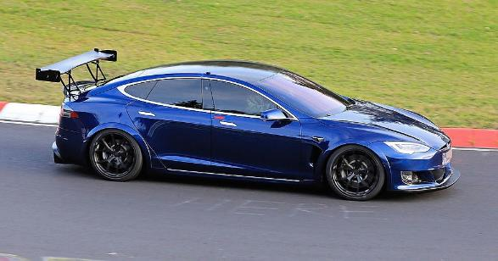
Vehicle Models
Tesla Model S being unveiled on Mar 26 2009 By Elon Musk
A Tesla Model S being tested in Nürburgring

Slide 47
Vehicle Models: Model S
With an estimated 50,931 units sold in 2016, the Model S ranked was the world's best-selling plug-in car for the second year in a row.
As of September 2018, the Model S, with global sales of 250,000 units, ranks as the world's second bestselling plug-in electric car in history after the Nissan Leaf (over 350,000 units).

Slide 48
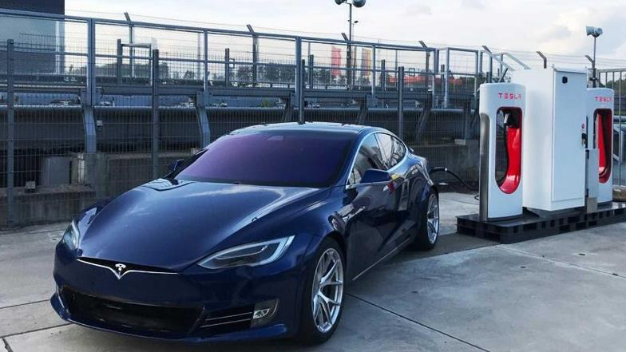
Vehicle Models: Model S
A Tesla Model S being recharged

Slide 49
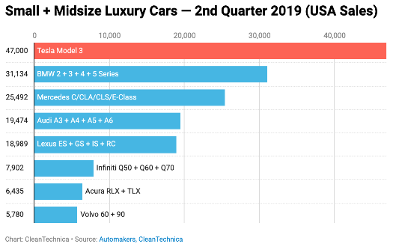
Vehicle Models : Model S
Comparison of Tesla Model S vs other Small+Midsize Luxury Cars (2nd quarter 2019 USA sales)

Slide 50
Vehicle Models
Model 3
The Model 3 (originally stylized as "☰"), a four-door sedan, is Tesla's third-generation car.
The car was originally intended to be called the Model E, but after a lawsuit from Ford that holds the trademark on "Model E”, Musk announced on July 16, 2014 that the car would be called "Model 3" instead.
On March 31, 2016, Tesla unveiled the car. Potential customers began to reserve spots on March 31 with a refundable deposit.
Tens of thousands were reported waiting to reserve their spot As of April 7, 2016, one week after the unveiling, Tesla reported over 325,000 reservations, representing sales of over US$14 billion.

Slide 51
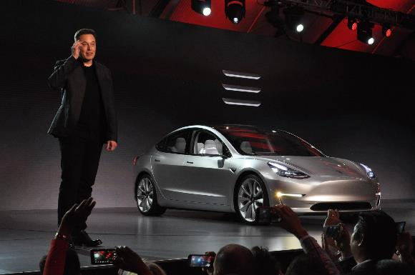
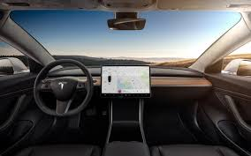
Vehicle Models
Elon Musk Unveiling the Model 3
Tesla Model 3 Interiors

Slide 52
Vehicle Models(Model 3)
Tesla expected to invest between US$2 billion and US$2.5 billion in capital expenditures to support Model 3 production.
Limited vehicle production began in July 2017, with the first 30 units delivered at a special event on July 28.
Customer deliveries totaled 1,764 units in the U.S. in 2017. In June 2018 production reached 5,000 per week.

Slide 53
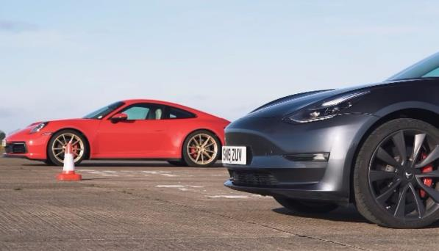
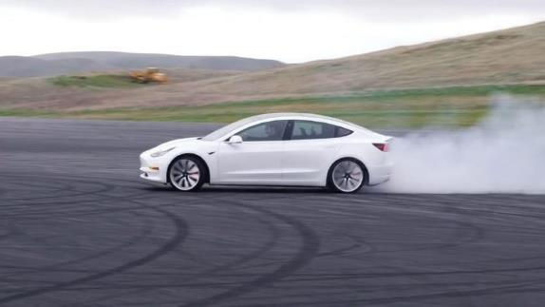
Vehicle Models(Model 3)
Tesla model 3 vs Porsche 911 Carrera
Tesla Model 3 in Track Mode

Slide 54
Vehicle Models
3. Model X
The Tesla Model X is a mid-size crossover SUV with a lightweight aluminum body.
Model X deliveries started in September 2015. It is offered in 5-, 6- and 7-passenger configurations.

Slide 55
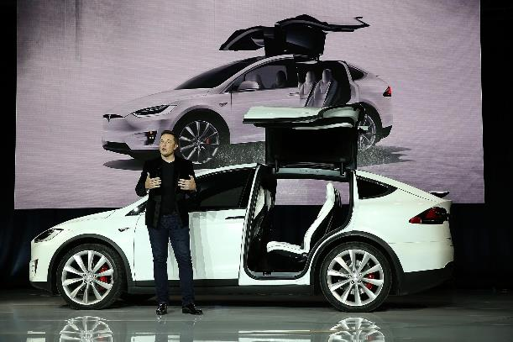
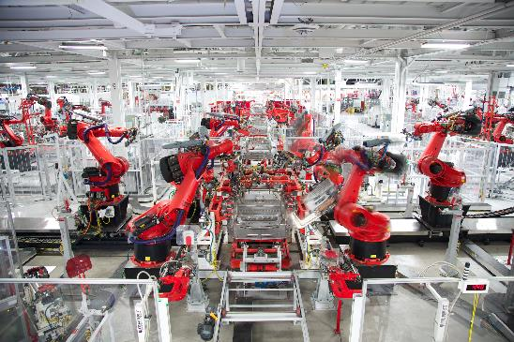
Vehicle Models
Elon Musk unveiling the Model X
Model X Assembly line at Freemont CA

Slide 56
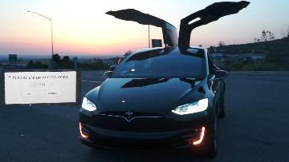
Vehicle Models : Model X
In September 2016, the Model X ranked as the top selling plug-in electric car in Norway.
Previously, the Model S had been the top selling new car four times. Cumulative sales since inception totaled 106,689 units through September 2018.
United States is its main market with an estimated 57,327 units sold through September 2018.
A Tesla Model X in Celebration Mode

Slide 57
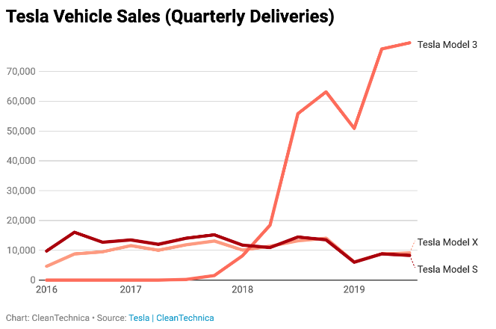
Vehicle Models : Model X
Quarterly Sales of Model X vs other Tesla models

Slide 58
Vehicle Models : Model Y
In August 2013, Tesla trademarked the name "Model Y”. In October 2015, Musk described a future "Model Y”. In August 2017, Tesla announced that the Model Y would use the Model 3 platform.
In February 2018, Tesla announced that they would unveil Model Y production plans within the next 3–6 months and posted open positions for Model Y production and design.
In May 2018, Musk said that the Model Y will be built on a platform that shares many components with the Model 3, and that the Model Y will be in production at the earliest in early 2020.

Slide 59
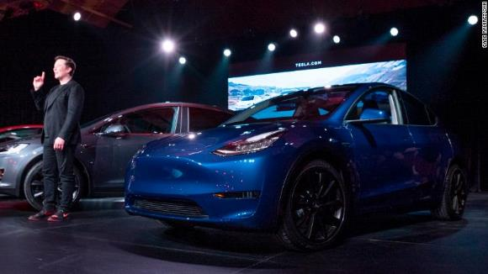
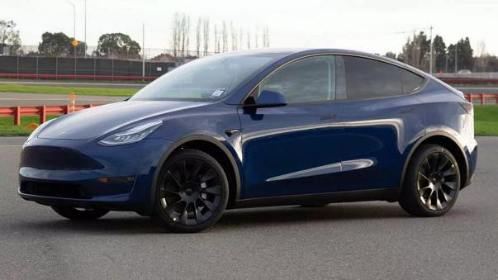
Vehicle Models : Model Y
Unveiling of Model Y

Slide 60
Table 1. Range and prices of Model 3,Model X, and Model S
Model and Version | Range | Base Price | Fully Loaded
Model 3 Standard Range Plus | 250 miles | $39,900 | $51,490
Model 3 Long Range | 322 miles | $48,990 | $60,490
Model 3 Performance | 322 miles | $56,990 | $66,990
Model S Long Range | 373 miles | $79,990 | $95,490
Model S Performance | 348 miles | $99,990 | $115,990
Model X Long Range | 328 miles | $84,990 | $106,490
Model X Performance | 305 miles | $104,990 | $128,490

Slide 61
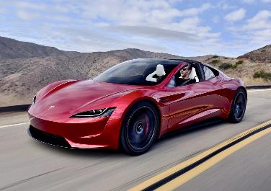
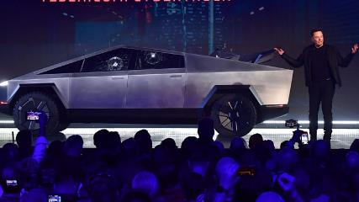
Upcoming models: Tesla Cybertruck price, Tesla Model Y price, and Tesla Roadster price
Model | Base Price | Max Price | Expected Launch
Cybertruck | $39,900 | $76,900 | Late 2022
Model Y | $48,800 | $74,000 | Early 2021
Roadster | $200,000 | $250,000 | Unclear
The Tesla Roadster
Tesla Cybertruck Unveiling

Slide 62
Tacit Knowledge sharing
https://youtu.be/m7atGkba-Z8
Cybertruck launch , which created a whole new sensation and resulted in a massive pre bookings of the cybertruck
Source:Verge

Slide 63
Factories And Markets
Tesla's first assembly plant occupies the former NUMMI plant in Fremont, California. It is known as the Tesla Factory.
As of 2016, the plant was not highly automated—it was expected to produce some 80,000 cars with 6,000 workers compared to a "typical" plant that might produce 250,000 cars with 3,000 workers.
In 2015, Tesla acquired Riviera Tool & Die (with 100 employees in Michigan), one of its suppliers of stamping items. In 2017, Tesla acquired Perbix Machine Company, a manufacturer of automated manufacturing equipment, that had been an equipment supplier for over three years.
Tesla occupies a second factory in Fremont. The building is more than 500,000 sq. ft (46,500 m2). The location is next to a SolarCity facility, a few miles from the original Fremont plant.

Slide 64
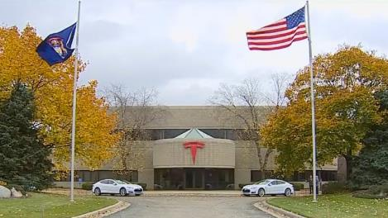
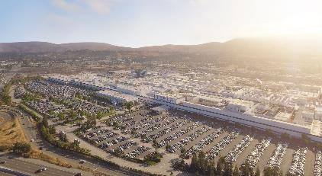
Factories And Markets
Tesla Factory : Freemont CA
Tesla Tool And Die Factory Michigan

Slide 65
Factories And Markets
Giga Nevada is located outside Reno, Nevada. As of January 2017, it occupied 1.9 million square feet (180,000 m2) with 4.9 million square feet (460,000 m2) of usable area across several floors.
It produces Power walls and Powerpacks as well as battery cells in partnership with Panasonic. It also produces Model 3 battery packs and drivetrains. The factory received substantial subsidies from the local and state governments.

Slide 66
Factories And Markets
Giga New York is located in Buffalo, New York on the site of a former Republic Steel plant. It is operated by Tesla's SolarCity unit.
The factory is a $750 million, 1.2-million-square-foot (0.11 km2) facility that directly employs 500 workers. Tesla partnered with Panasonic to assemble photovoltaic panel modules.

Slide 67
Factories And Markets
Tesla received incentives to locate the factory in Buffalo through the Buffalo Billion program. As of August 2017, the factory added production of solar tiles for the Tesla Solar Roof.
In January 2018, Tesla announced, after testing on employees' roofs, that it would begin installing the Tesla Solar Roof on customers' homes "within the next few months”.

Slide 68
Factories And Markets
In Europe
Tesla opened its first European store in June 2009 in London. Tesla's European headquarters are in Amsterdam.
A 62,000 sq. ft (5,800 m2) European service centre operates in Tilburg, Netherlands, along with a 77,650 m2 (835,800 sq ft) assembly facility that adds drivetrain, battery and software to the (imported) car body to reduce EU import tax.
In late 2016, Tesla acquired German engineering firm Grohman Engineering in Prüm as a new division dedicated to helping Tesla increase the automation and effectiveness of its manufacturing process.
After winding down existing contracts with other auto manufacturers, Grohman works exclusively on Tesla projects.

Slide 69
Factories And Markets
In Asia
Tesla Motor's Japanese showroom in Aoyama, Tokyo, which was the first showroom opened in the country.
Showrooms and service centers operate in Hong Kong, Beijing and Shanghai. Tesla opened its first Japanese showroom in Tokyo, Japan, in October 2010.
In South Korea, it opened two showrooms in March 2017 and a service centre in late 2017. In August, 2017, Taiwan opened its first service centre and showroom.
In July 2018, Tesla signed an agreement with Chinese authorities to build a factory in Shanghai, China, which is Tesla's first Gigafactory outside of the United States.

Slide 70
Factories And Markets
Australia
Tesla opened a showroom in Sydney's Martin Place in 2010, followed by a showroom and service centre in Melbourne in 2015. By 2019, Tesla had opened 4 service centers in Australia.
South America
In February 2020, several news sites reported that Tesla was negotiating with the Brazilian Minister of Science, Technology and Innovation, Marcos Pontes to build a Gigafactory in the state of Santa Catarina, Brazil.
Tesla vehicles could then be exported to other nearby markets, such as Argentina, Chile, Paraguay, Uruguay, Colombia, the Caribbean region, and even Mexico, a country with which Brazil has a free trade agreement.

Slide 71
Case Study: How Tesla Changed the Auto Industry
Tesla is forcing the auto industry to rapidly change. Large, established automakers now are making fully electric and hybrid electric cars.
Automakers are starting to explore and include artificial intelligence (AI) in their cars, and now major automakers and U.S. Congressmen are discussing autonomous vehicles (AVs) and how best to innovate and regulate them.
Not only that, but Tesla's software design is state-of-the-art: the fact that Tesla can update vehicle software over-the-air (OTA) as if it were Apple updating an iPhone is unprecedented.

Slide 72
How Tesla Changed the Auto Industry
Tesla is forcing the auto industry to change rapidly
Tesla didn't invent the electric car (Scottish inventor Robert Anderson did, in 1832), but it was Tesla who popularized, pioneered and promoted the electric car ever since the company's founding in 2003.
None of the major automotive manufacturers were making electric cars until Tesla made it cool in 2008 with its bombastic announcement of the first luxury electric car: The Tesla Roadster.

Slide 73
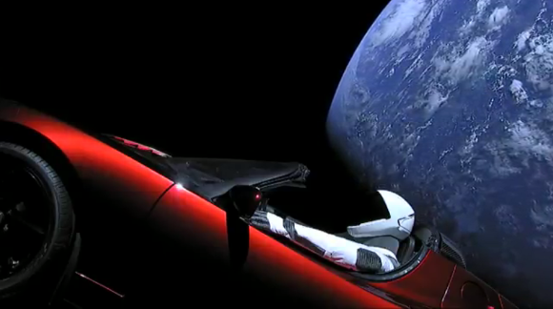
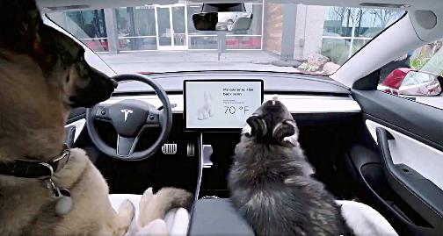
Case Study: How Tesla Changed the Auto Industry
Tesla Roadster orbiting earth
Tesla’s Dog Mode in Action

Slide 74
Case Study: Tesla is forcing the auto industry to change rapidly
Since then, big automakers with lots of capital, solid supplier bases and seasoned supply chains went to work in rapidly developing and churning out their own electric cars, as consumers and governments pursue eco-friendly, low-emissions transit options.
The next electric car, released in 2010, was made by Mitsubishi Motors. According to the Bureau of Transportation Statistics data, the number of hybrid EVs sold in the U.S. didn't break 100,000 until 2005.
The bureau doesn't have data on the number of EVs sold until 2011, which was 9,750.

Slide 75
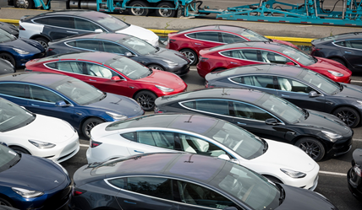
Case Study: Tesla is forcing the auto industry to change rapidly
Brian Loh, a partner at McKinsey & Company;, said innovation is at an "all-time high" in the auto industry right now, which is significant because historically, the auto industry is very slow to evolve.
Tesla Model 3 ready to be shipped

Slide 76
Problems Faced By Tesla
Tesla's supply chain is it's Achilles' Heel
Tesla doesn't meet deadlines. Tesla doesn't meet market expectations. Tesla delivers cars riddled with defects. Last fall, Tesla missed Model 3 production goals in Q3 2017 due to supplier issues, and ended up having to redesign a key part of the Model 3.
What CEO Elon Musk called "production bottlenecks" continued through Q4 2017, although by then Tesla was no longer blaming suppliers, and told investors in February that the company would produce 5,000 Model 3s a week by the end of Q2 2018.
Almost all of these problems can be attributed to lack of funding and the fact that Tesla is still a small company.

Slide 77
Problems Faced By Tesla
Tesla's supply chain is still in the development phase, and right now Tesla doesn't have the capital and supplier relationships that other big automakers have. “For better or worse, Tesla makes its own batteries, so it's heavily dependent on its own sources," said Michelle Anderson, a partner with Boston Consulting Group.

Slide 78
Problems Faced By Tesla
Because Tesla's supply chain often relies on single source suppliers, one can quickly fit the puzzle pieces together to see how and why Tesla has struggled.
According to a Tesla statement provided by CSIMarket, the electric car manufacturer does have more supply chain volatility than other automakers.

Slide 79
Problems Faced By Tesla
“While we obtain components from multiple sources whenever possible, similar to other automobile manufacturers, many of the components used in our vehicles are purchased by us from a single source," the statement reads.
"To date, we have not qualified alternative sources for most of the single sourced components used in our vehicles and we generally do not maintain long-term agreements with our suppliers.

Slide 80
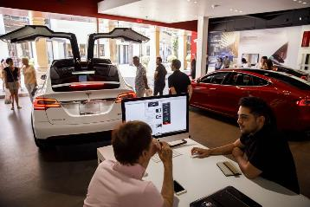
Problems Faced By Tesla
While we believe that we may be able to establish alternate supply relationships and can obtain or engineer replacement components for our single source components, we may be unable to do so in the short term or at all at prices or costs that are favorable to us.
Tesla Staff interacting with customers

Slide 81
Problems Faced By Tesla
Tesla suffers from a lack of funding and narrow supplier base
Supply chains are critical to an automaker's success, but the most critical part of the automaker's supply chain is its relationship with suppliers — and that might be where Tesla is weakest.
Typically, an OEM will have a supplier panel or a collection of a few suppliers, anywhere from 2-5 suppliers they source from for that commodity.

Slide 82
Problems Faced By Tesla
Then there's the funding problem. Tesla is technically still in the red — the company isn't profitable yet, and many critics use that fact as their main reason for arguing that Tesla isn't worth investment or even worth paying attention to.
But when it comes to suppliers, Tesla's lack of funding is a huge issue. For example, Tesla is trying to ramp up production of the Model 3, necessitating a high volume of parts and components from its suppliers. Because of that capital outlay, Tesla might hold off on paying upfront costs for the parts and wait until the car starts selling before paying suppliers.

Slide 83
Problems faced by Tesla
But because Tesla is still learning how to mass produce electric cars — relatively speaking, Tesla is still new to the auto industry — production problems still arise, making it increasingly difficult to sell and deliver quality cars at an efficient rate.
Tesla Deliver’s on its promises, just not always on time
For all of the problems Tesla is now experiencing with the Model 3, the company already experienced with the Model S.

Slide 84
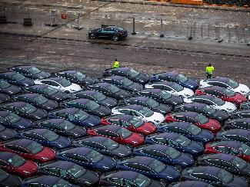
Problems faced by Tesla
At this point, most of the wrinkles in Model S production have been ironed out. That may instill some hope in investors, but the fact remains that Tesla still has inroads to make as a trusted automaker.

Slide 85
Tacit Knowledge sharing
https://www.youtube.com/watch?v=uutpyRhKNko&t=285s
A small research by verge depicting how Tesla plans to overcome the supplier chain problem and achieve vertical integration

Slide 86
Problems faced by Tesla
Tesla has proved is that it takes a tremendous amount of funding, grit and hard work, star power and a strong vision in order to succeed in the auto industry and launch a radical new product — especially if you're trying to do both those things at the same time.
The fact that Tesla is still around 15 years after its commencement is impressive all by itself. "On one hand, ramping up a car company from scratch is really hard," said Greg Keffer, vice president of marketing at GT Nexus.
Tesla shows how crucial it is for an automaker — or any company, really — to have all the kinks worked out of its supply chain before pursuing such big goals, like skipping the prototype stage and rushing to produce 5,000 cars a week right away, which is how Tesla approached the Model 3.

Slide 87
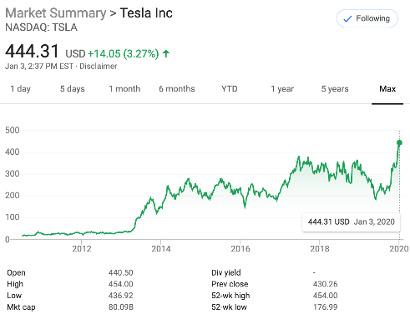
Additional Info: Stock Prices
A Graph showing the rise and fall in the stock prices of tesla over the last 10 years

Slide 88
Conclusion
Tesla has struck the right cords in terms of marketing, Tesla did not hire a single celebrity to market its products , Tesla let the features of the car speak for themselves.
Tesla has managed to change the general perspective that people had on electric cars
Elon Musk managed to capture the “meme industry” to further market tesla

Slide 89
Conclusion
Although Tesla scores top points in terms of marketing and features , where it lags behind is in terms of delivery.
The major reason behind this failure is due to the supply chain problems that tesla faces due to its parts suppliers
To avoid retail delays and problems associated with dealerships , Tesla is moving online, Tesla has started selling its products online in select regions , to make the life of an average consumer easy.

